Slide 1
Gear Manufacture

Slide 2
Gear Manufacture
Small gears are frequently made from wrought plate or bar, with the hub, web, spokes, and rim machined to final or near final dimensions before the gear teeth are produced.
The face width and the outside diameter of the gear teeth are also produced at this stage.
A few gears in which only moderate precision is required may be die cast with the teeth in virtually final form.

Slide 3

Gear Manufacturing Process

Slide 4
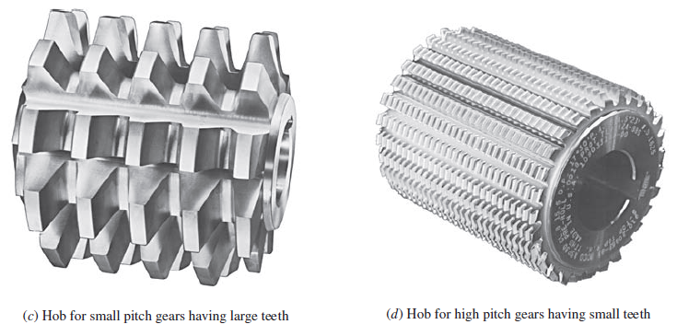
Gear Cutting Processes

Slide 5
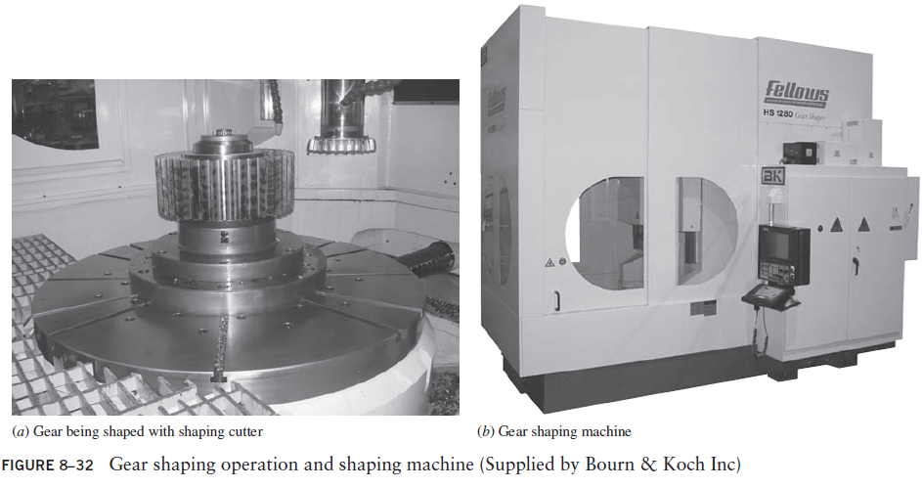
Gear Cutting Machine

Slide 6
Gear Quality
Ensuring proper dimensional accuracy of power-transmission gears is essential to their suitability for use in machinery.
Stresses in gears, smoothness of operation, life, and noise are affected by the degree of precision obtained in manufacturing.

Slide 7
Gear Quality
Quality in gearing is indicated by either of two methods:
the composite variation of a product test gear rotating in mesh with a precise master gear, called functional measurement.
the precision of specific features of a single gear, called analytical measurement.

Slide 8
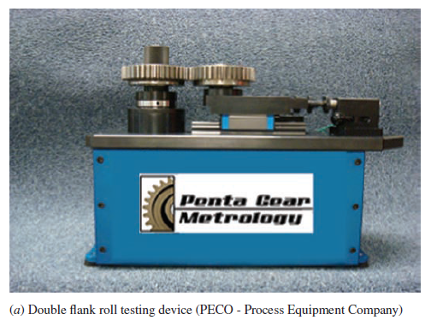
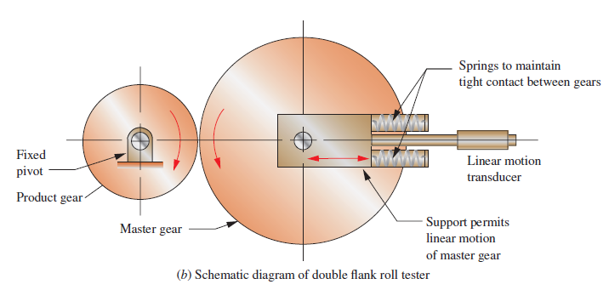

Functional Measurement

Slide 9
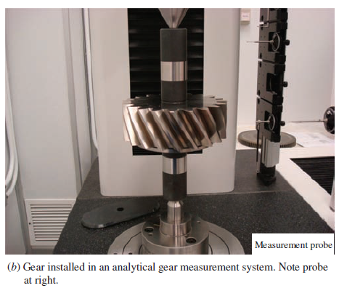
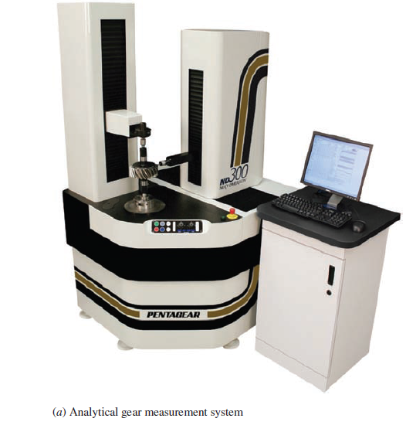
Analytical Measurement

Slide 10
Velocity Ratio and Gear Trains
Gear Train
A gear train is one or more pairs of gears operating together to transmit power
Velocity Ratio
The velocity ratio (VR) is defined as the ratio of the rotational speed of the input gear to that of the output gear for a single pair of gears.

Slide 11
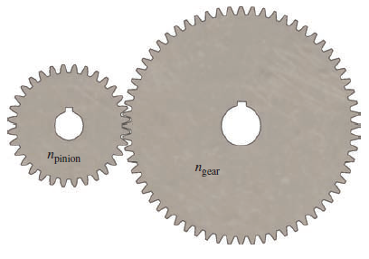
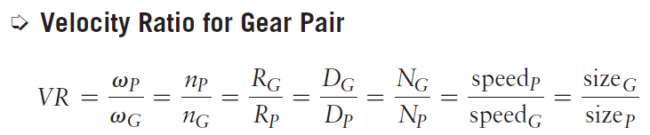
Velocity Ratio

Slide 12
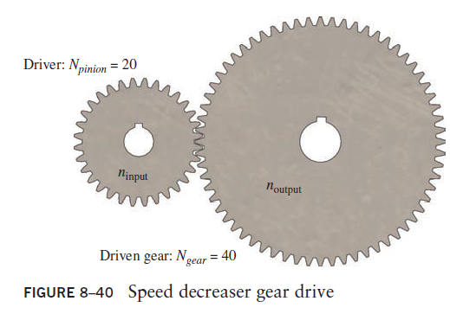
Example Problem
Figure shows a gear pair in which a 20-tooth pinion drives a 40-tooth gear. The pinion has an angular velocity of 1000 rpm. Determine the velocity ratio and the angular velocity of the gear.

Slide 13
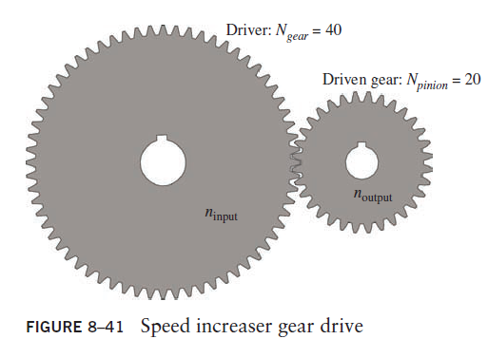
Example Problem
Let’s take the gear and place it on the input drive shaft and place the pinion on the output drive shaft as shown. The 40-tooth gear is now the input and drives the 20-tooth pinion which in now the output. Determine the velocity ratio and the output angular velocity if the input shaft rotates at 1000 rpm.

Slide 14
Train Value
When more than two gears are in mesh, the term train value (TV) refers to the ratio of the input speed (for the first gear in the train) to the output speed (for the last gear in the train).
By definition the train value is the product of the values of VR for each gear pair in the train.

Slide 15
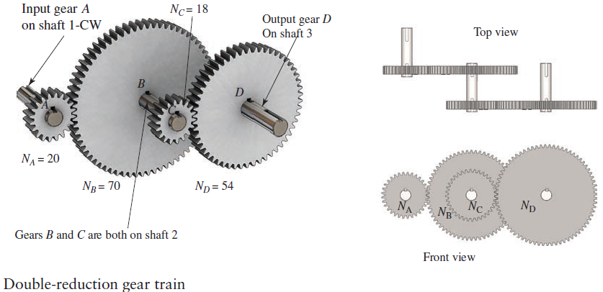
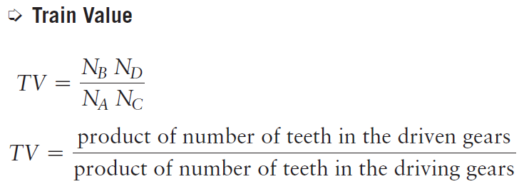
Gear Trains

Slide 16
Positive or Negative Train Vlaue
We will use the term positive train value to refer to one in which the input and output gears rotate in the same direction. Conversely, if they rotate in the opposite direction, the train value will be negative.

Slide 17
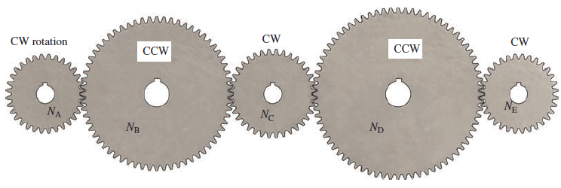
Idler Gear
Any gear in a gear train that performs as both a driving gear and a driven gear is called an idler gear or simply an idler.

Slide 18

Gear Reducer
Ensuring proper dimensional accuracy of power-transmission gears is essential to their suitability for use in machinery.
Stresses in gears, smoothness of operation, life, and noise are affected by the degree of precision obtained in manufacturing.

Slide 19
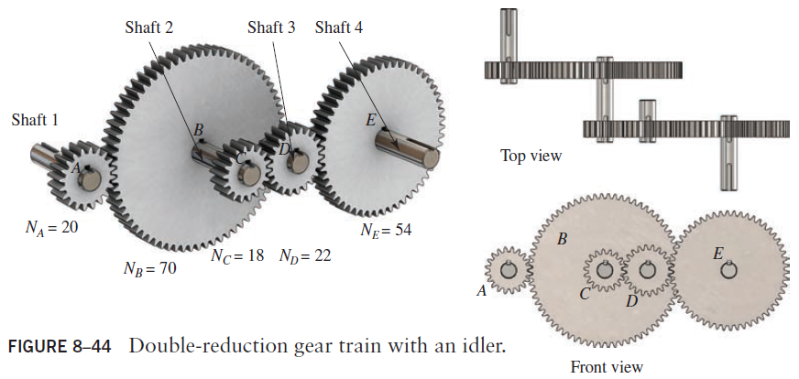
Example Problem
Determine the train value for the train shown below. If the shaft carrying gear A rotates at 1750 rpm clockwise, compute the speed and the direction of the shaft carrying gear E.

Slide 20
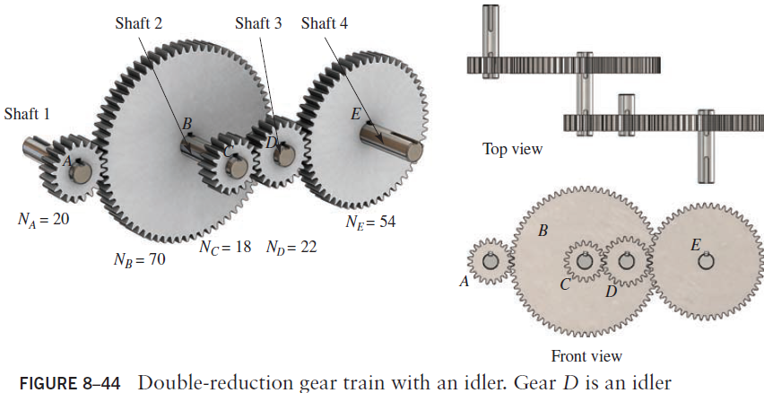

Slide 21
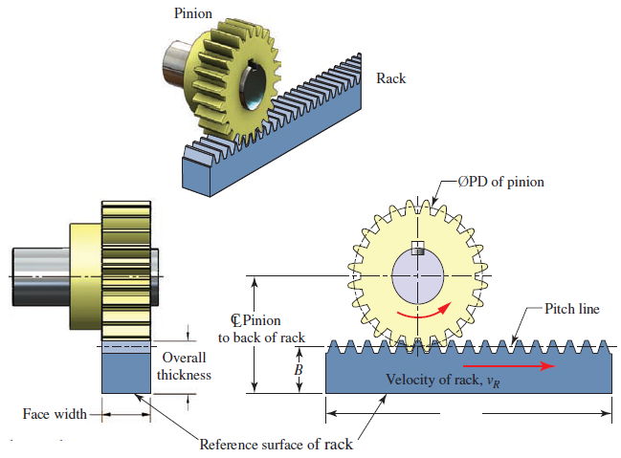
SELF READING
VELOCITY MEASUREMENT IN RACK AND PINION

Slide 22
Devising Gear Trains
Hunting Tooth
Some designers recommend that integer velocity ratios be avoided, if possible, because the same two teeth would come into contact frequently and produce uneven wear patterns on the teeth.
For example when using a velocity ratio of exactly 2.0, a given tooth on the pinion would contact the same two teeth on the gear with every two revolutions.

Slide 23
Devising Gear Trains
Hunting Tooth
A more uniform wear pattern will result if the velocity ratio in not an integer. Adding or subtracting one tooth from the number of teeth in the gear produces the result that each pinion tooth would contact a different gear tooth with each revolution and the wear pattern would be more uniform.
The added or subtracted tooth is called the hunting tooth.

Slide 24


Slide 25
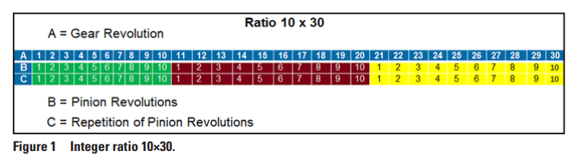
In the case of an integer ratio for example 10×30, there will be three pinion revolutions and one ring gear revolution until the cycle repeats
For example, pinion tooth 1 will mesh strictly with the slots 1, 11 and 21 of the gear.
The second sequence of pinion revolutions in row “C” is merely a repetition of the first three pinion revolutions in row “B.”
The pinion rotation blocks do not shift because of the integer ratio.

Slide 26
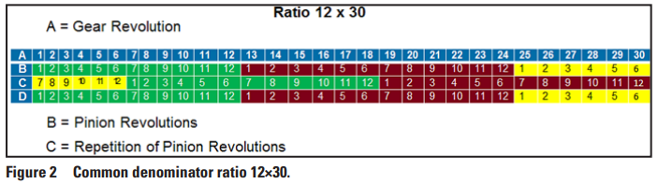
In the case of a ratio 12×30,
Nevertheless, in both cases, the pinion teeth mesh in groups of gear slots.
In Figure 1 these are three groups and in Figure 2 these are five groups. Only meshing between the groups is possible for the defined ratios.

Slide 27
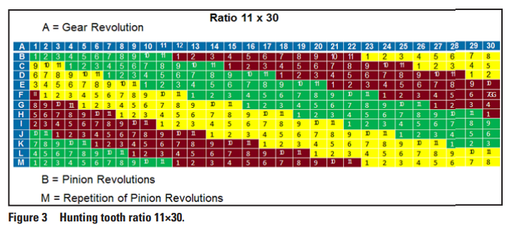
It requires the pinion revolutions in rows “B” to “L” until one hunting tooth sequence is finished. Row “M” has the identical phase relationship as row “B” and therefore presents the first repetition
The cycle repetition happens after the gear performs a number of revolutions, equal to the number of pinion teeth.
This is of course also true if the pinion preforms a number of revolutions equal to the number of gear teeth.
The number of revolutions to achieve “one tooth hunting sequence” is independent from the fact if the number of teeth are prime numbers or if simply one number is even and the other number is odd.

Slide 28
It requires the pinion revolutions in rows “B” to “L” until one hunting tooth sequence is finished. Row “M” has the identical phase relationship as row “B” and therefore presents the first repetition
In each pinion revolution, each pinion tooth to mesh with a different gear slot.
However, in one revolution each pinion tooth can only mesh with one gear slot.
In order to cover all gear slots, the pinion has to rotate for each gear slot once which is then called the hunting tooth number of rotations.

Slide 29
GENERAL PRINCIPLES FOR DEVISING GEAR TRAINS
The velocity ratio for any pair of gears can be computed in a variety of ways.
The number of teeth in any gear must be an integer.
Mating gears must have the same tooth form, pressure angle, and pitch.
When external gears mesh, there is a direction reversal of their shafts.
When an external pinion meshes with an internal gear, their shafts rotate in the same direction.

Slide 30
GENERAL PRINCIPLES FOR DEVISING GEAR TRAINS
An idler is a gear that performs as both a driver and a driven gear in the same train. Its size and number of teeth have no effect on the magnitude of the train value, but the direction of rotation is changed.
Spur and typical helical gears operate on parallel shafts.
Bevel gears, crossed helical gears, and a worm/wormgear set operate on shafts perpendicular to each other

Slide 31
GENERAL PRINCIPLES FOR DEVISING GEAR TRAINS
The number of teeth in the pinion of a gear pair should not be such that it causes interference with the teeth of its mating gear.
In general, the number of teeth in the gear should not be larger than about 150. This is somewhat arbitrary, but it is typically more desirable to use a double-reduction gear train rather than a very large, single-reduction gear pair.
Any given gear train design problem may require one or more pairs of gears depending on the overall train value required, space available, and practical gear size.

Slide 32
GENERAL PRINCIPLES FOR DEVISING GEAR TRAINS
It is generally desirable to design the gear train with the fewest practical number of gears. Each added gear requires its own shaft that must be supported by bearings.
In general, it is expected that the overall gear train be small in size, compact, and arranged in a manner that facilitates assembly.
You should determine the required directions of the driver for the gear train and for the output shaft; at least whether the input and output should rotate in the same direction (a positive train) or the opposite direction (a negative train).

Slide 33
GENERAL PRINCIPLES FOR DEVISING GEAR TRAINS
The use of the “hunting tooth” concept described above for any gear pair is desirable. However, in this book we will consider any practical ratio for a given gear pair to be acceptable.
Gear pairs operating at slower speeds will be subjected to higher torque and tooth loads as compared with those operating at higher speed. This results in the slower gear teeth having a larger tooth size and circular pitch for a given velocity ratio. For this reason, it is desirable to allocate a higher percentage of the total train value to the higher speed pairs of gears to obtain a more optimal overall design for the train.

Slide 34
Designing Gear Trains
Three methods are discussed:
Single pair of gears to produce a desired velocity ratio: This is the fundamental process required to define the number of teeth in the pinion and the gear to produce a desired ratio.
Residual ratio: This process is used when two or more pairs of gears in a train are required. It calls for specifying all but one of the required ratios to produce an overall train value.
Factoring approach: When two or more pairs of gears in a train are required and an exact ratio for the overall train value is also required, then the velocity ratio of each gear pair must be a factor of the overall train value.

Slide 35
General Design Approach
Determine the overall train value, TV, required from the application data.
Determine the maximum velocity ratio, VR_{max}, that can be achieved with one pair of gears, considering a reasonable maximum number of teeth for the gear and a number of teeth for the pinion that will not result in interference according to Table 8–7.
If the train value is greater than the ratio found from Step 2, divide TV/VRmax. This will aid in determining how many pairs of gears are required.

Slide 36
General Design Approach
Note that the overall train value is the product of the velocity ratio for each pair of gears. That is,
TV = VR₁ x VR₂ x VR₃ . . .
Determine if an idler gear is necessary to achieve the required output shaft direction.
Specify each individual velocity ratio using the guidelines listed above.
Specify the numbers of teeth in each gear of each pair of gears.
Sketch the arrangement of the gears to show how they are placed on shafts in proper relation to each other. At this stage, a schematic diagram is adequate.

Slide 37
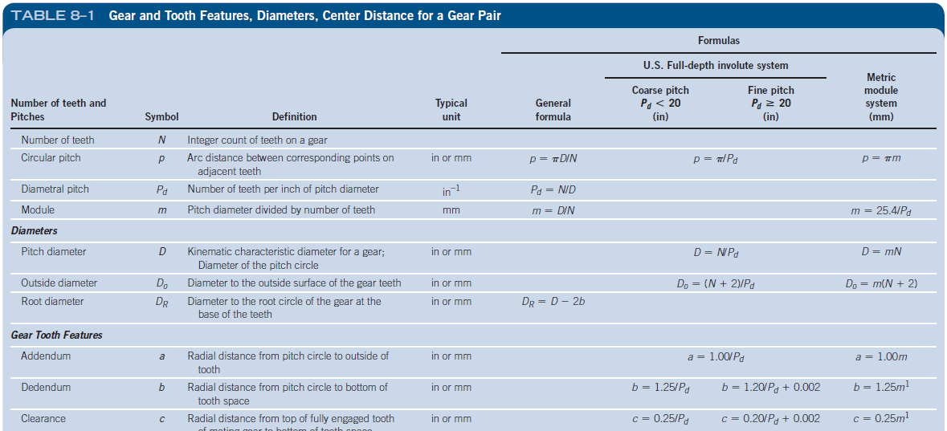
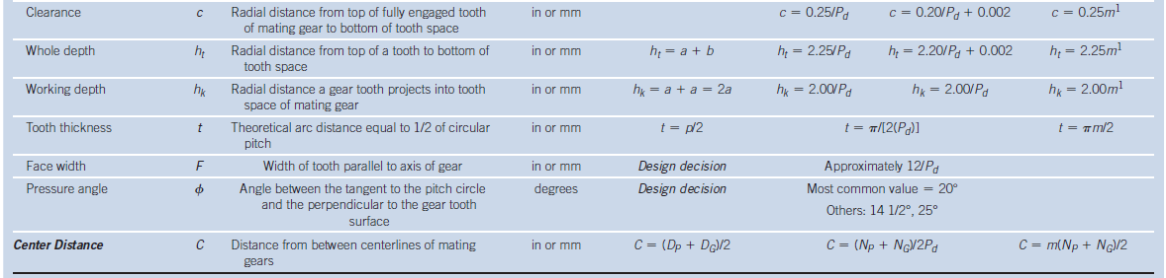
Spur Gears
When gears are large, the spoked design in Part (a) is often used to save weight. The gear teeth are machined into a relatively thin rim that is held by a set of spokes connecting to the hub.

Slide 38
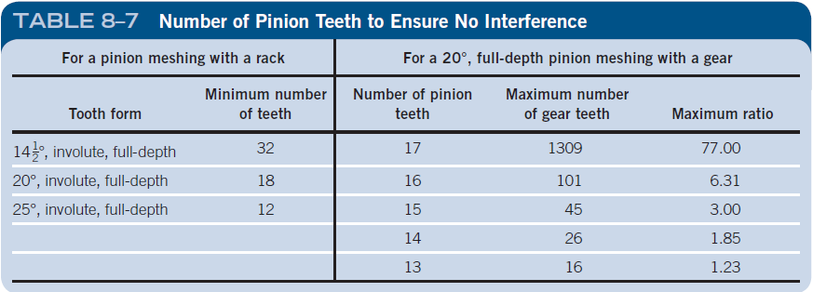

Slide 39
Example Problem: Design of a single gear pair
Devise a gear train to reduce the speed of rotation of a drive from an electric motor shaft operating at 3450 rpm to approximately 650 rpm. Use N_{max} = 150 teeth.

Slide 40
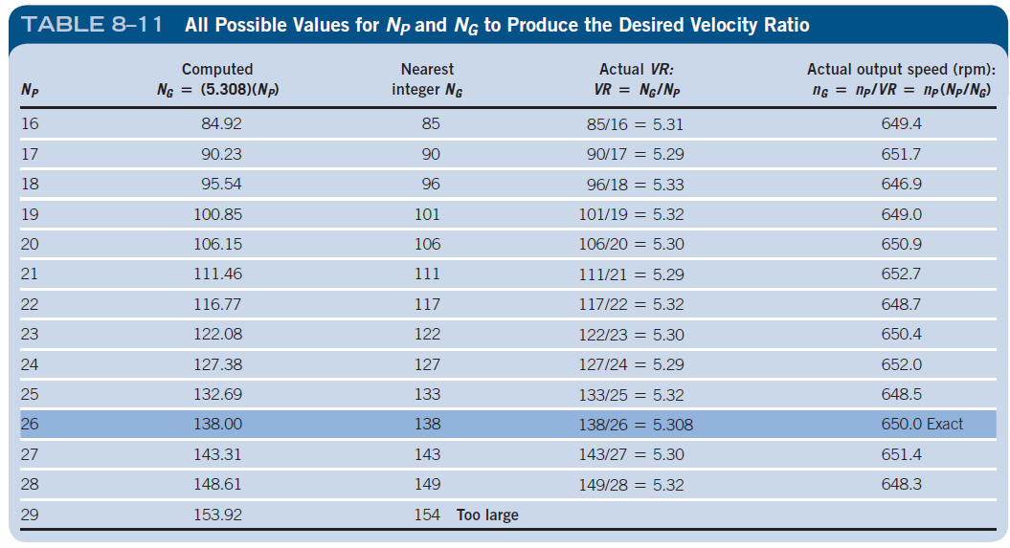

Slide 41
Example Problem: Residual Ratio Method
Devise a gear train for a conveyor drive. The drive motor rotates at 1150 rpm, and it is desired that the output speed for the shaft that drives the conveyor be in the range of 24 to 28 rpm. Use a double reduction gear train. Power transmission analysis indicates that it would be desirable for the reduction ratio for the first pair of gears to be somewhat greater than that for the second pair.

Slide 42
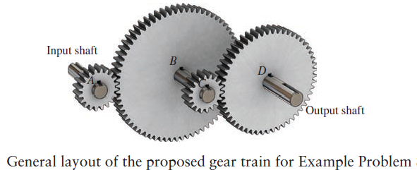

Slide 43
Example Problem: Factoring Approach
Devise a gear train for a recorder for a precision measuring instrument. The input is a shaft that rotates at exactly 3600 rpm. The output speed must be exactly 11.25 rpm. Use 20°, full-depth, involute teeth; no fewer than 17 teeth; and no more than 150 teeth in any gear.

Slide 44
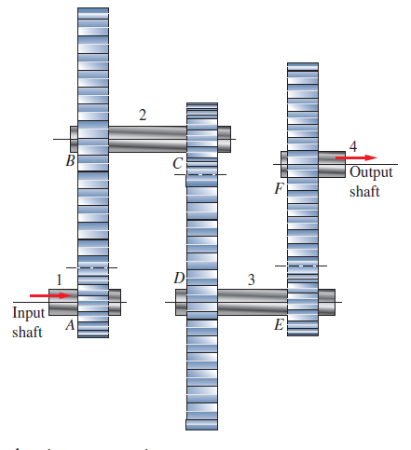
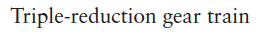

Slide 45
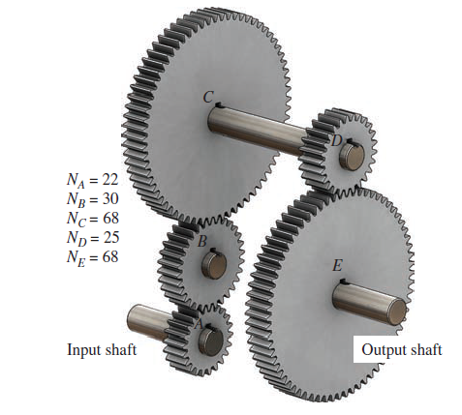
Example Problem
For the gear trains sketched, compute the output speed and the direction of rotation of the output shaft if the input shaft rotates at 1750 rpm clockwise.

Slide 46
Example Problem
Devise a gear train using all external gears on parallel shafts. Use 20° full-depth involute teeth and no more than 150 teeth in any gear. Ensure that there is no interference.
Sketch the layout for your design.
Input Speed(rpm) = 5500
Output Speed(rpm) = 13.0 to 14.0

Slide 47
Assigned topics (D.Y.S)
Assigned topics for Chapter:8 (D.Y.S)
8.8 (Bevel gear)
8.9 (Types of worm gearing)
8.10 (geometry of worms and worm gears)
Velocity of a Rack
Examples: 8.1, 8.2, 8.3, 8.4,8.6 to 8.12
Problems:
Gear geometry: 1 to 19
Velocity ratio: 20 to 36
Analysis of simple gear train: 37 to 40
Helical gearing: 42 to 44
Bevel gears: 45, 46
Wormgearing: 52, 53
Analysis of complex gear trains: 58 to 61
Kinematic design of single gear trains: 62 to 65
Kinematic design of gear trains: 66 to 80
Rack and pinion : 81

